Slide 1
Magic Cards
An educational game about Error Detection
Team: Magicians

Slide 2
Team Members
Chen Shi (010119005)
Jayam Malviya (011435567)
Miao Shi (010823527)
Prateek Sharma (011475620)

Slide 3
Design Patterns used in our Game
Design patterns:
State
Proxy
Composite
Decorator
Singleton

Slide 4
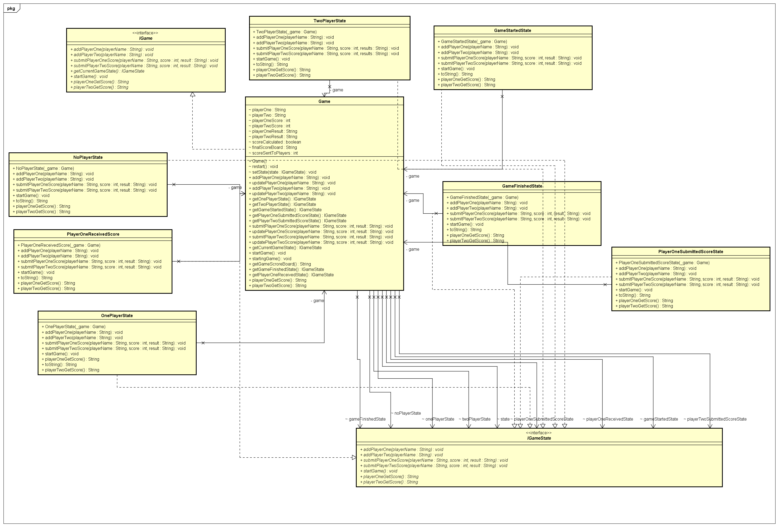
Class Diagram For State Pattern

Slide 5
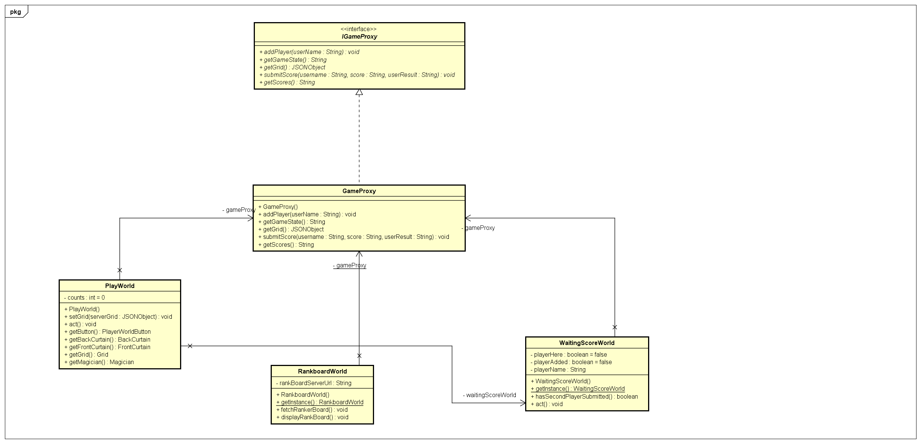
Class Diagram for Proxy Pattern

Slide 6
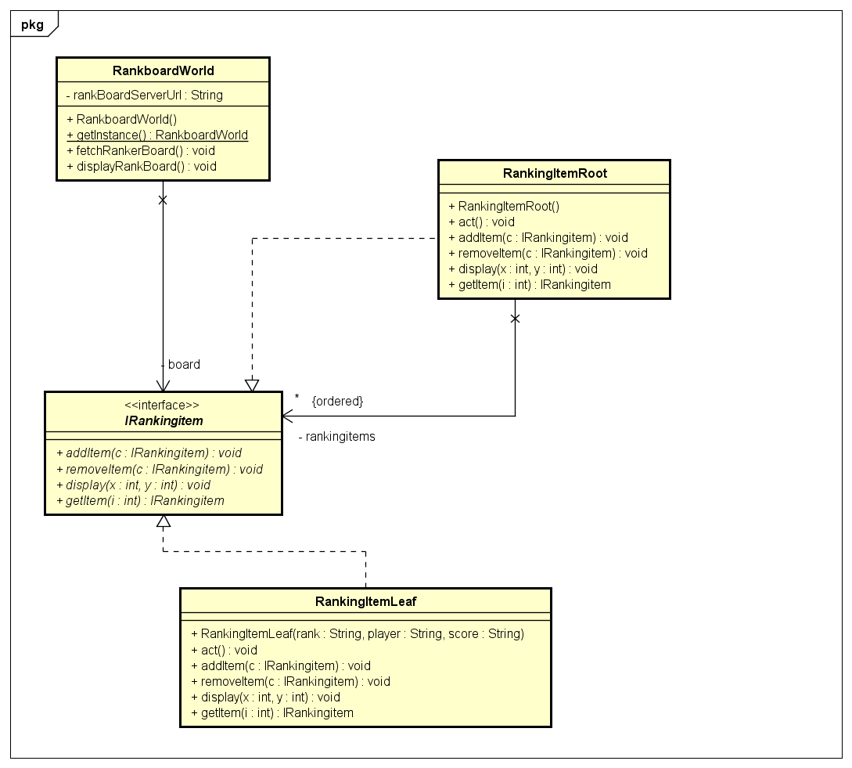
Class Diagram for Composite Pattern

Slide 7
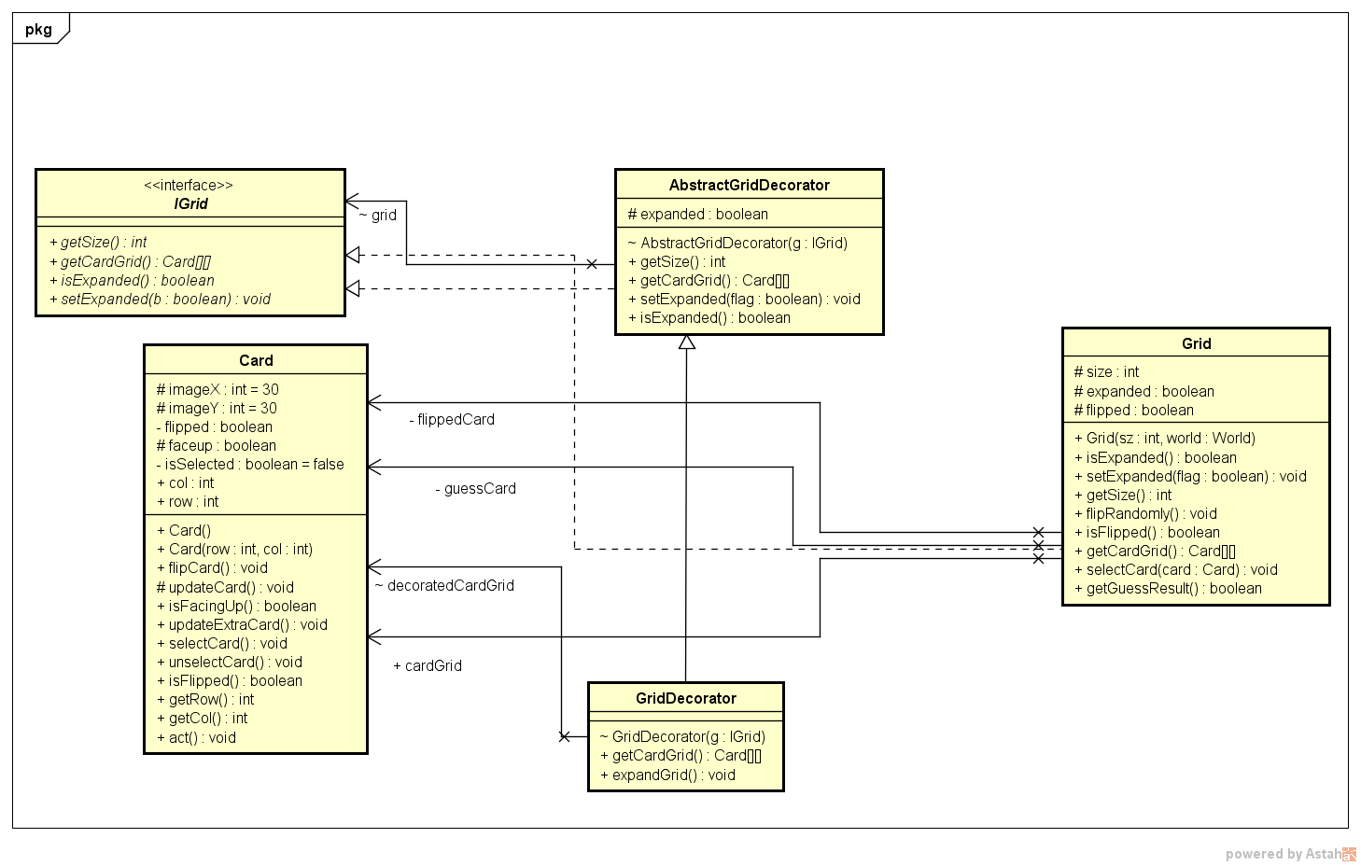
Class Diagram for Decorator Pattern

Slide 8
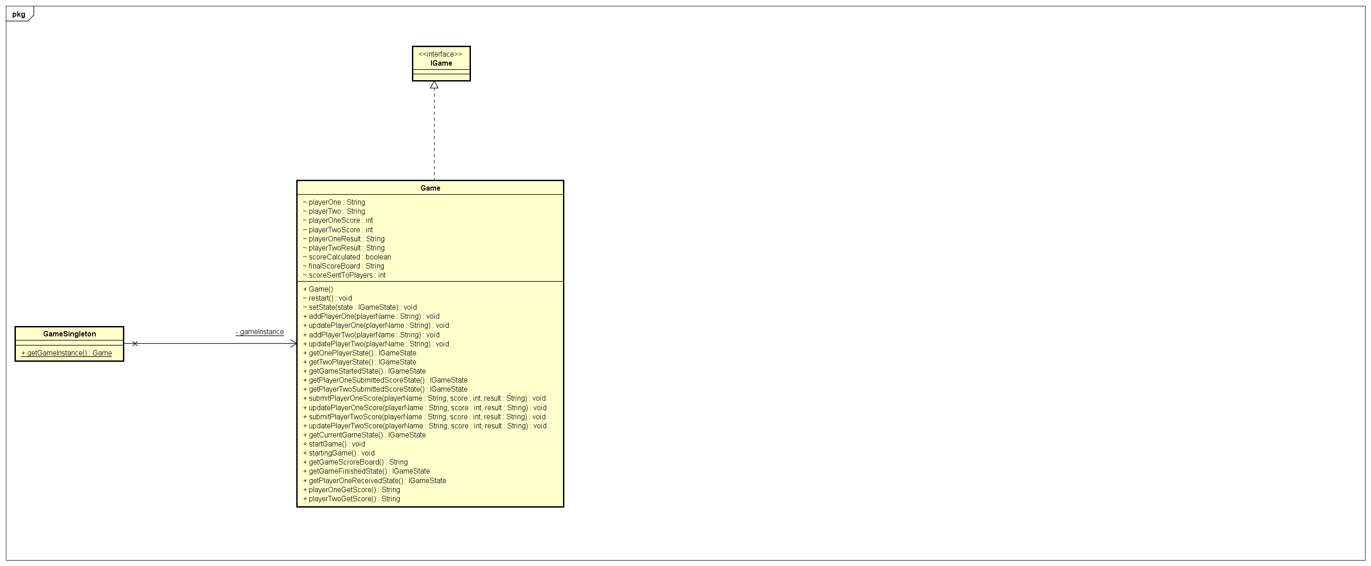
Class Diagram for Singleton Pattern

Slide 9
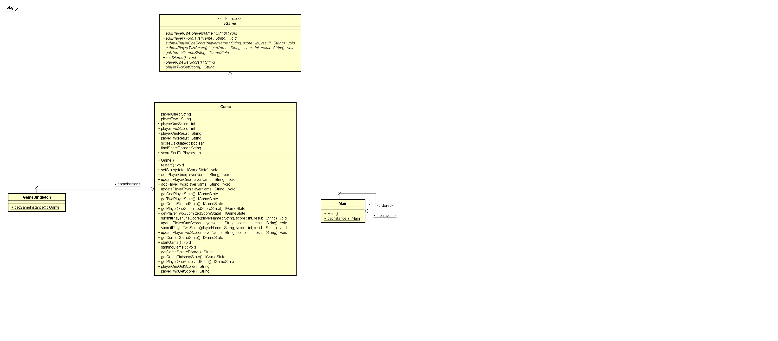

Slide 10
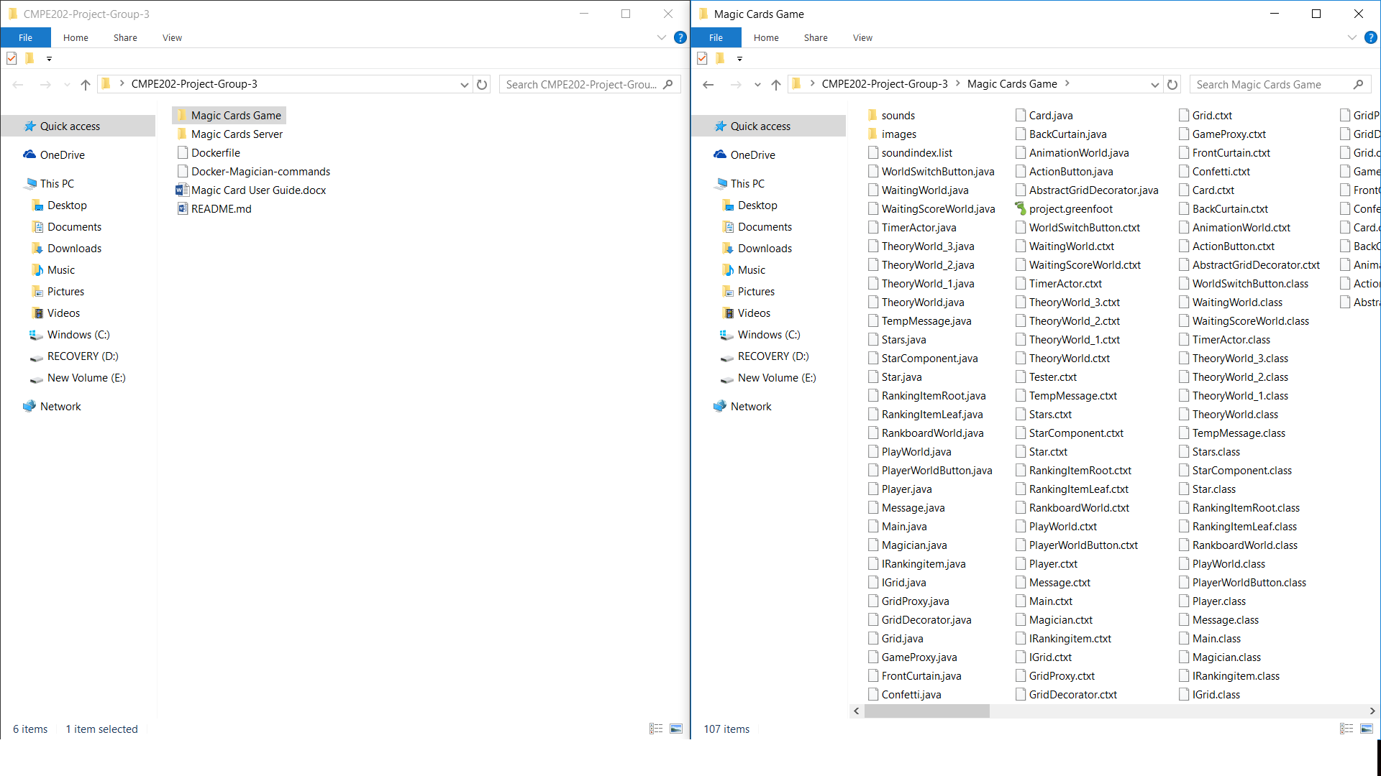
Source Code Organization

Slide 11
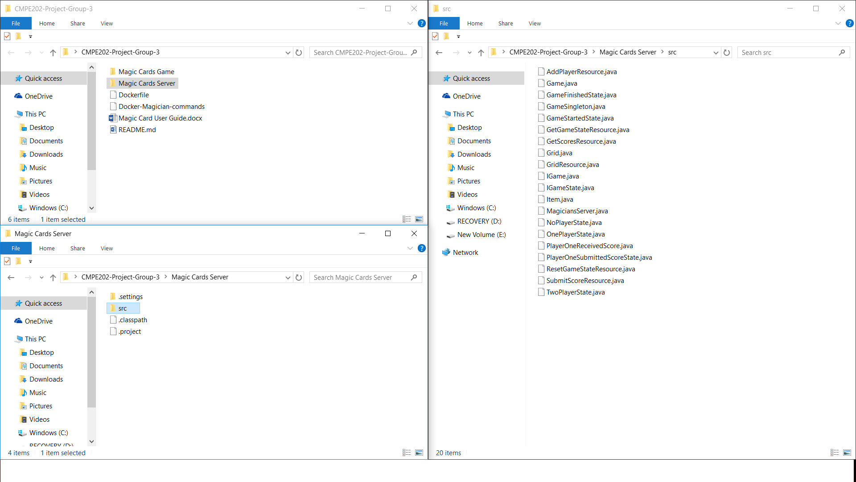
Source Code Organization

Slide 12
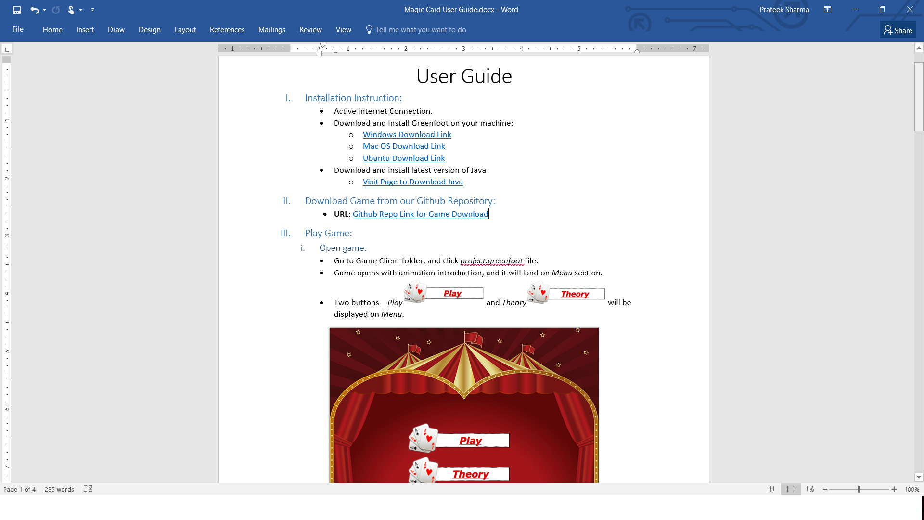
User's Guide Preview

Slide 13
Thank You!

